Slide 1
How to Make your
HTS Reset JIG
2020/07/07

Slide 2
Background
Some Samsung Y2015 BDP/HTS products are stuck at reboot loop
Samsung tech engineers world-wide worked together to find a better solution against this particular symptom
Factory reset was found to be a good solution to fix the issue. But applying the factory reset to HTS was a so tricky that the service engineer needs to try a specific steps of manual operations more than 30~40 times
This document provides a guide how a service engineer can make IR JIG
and repair

Slide 3
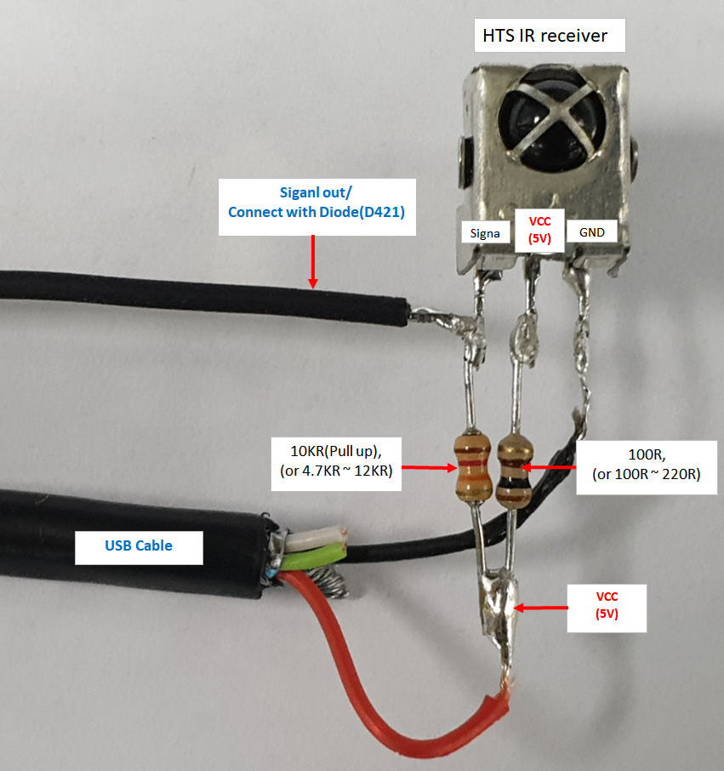
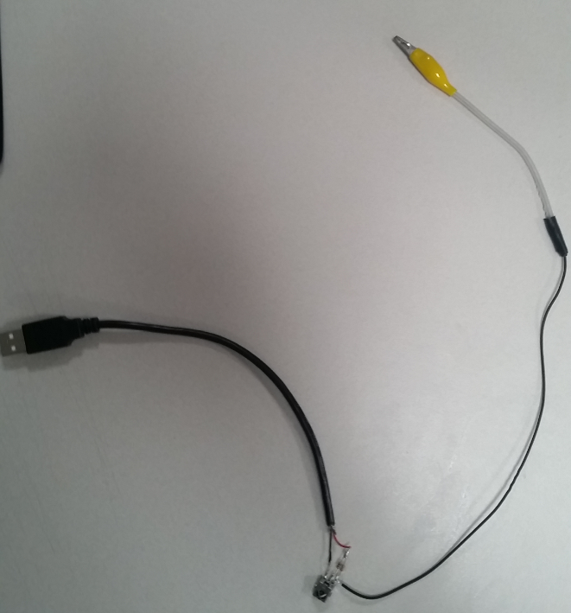
1. Make IR JIG
IR receiver
USB Cable
Siganl out/
Connect with Diode(D421)

Slide 4
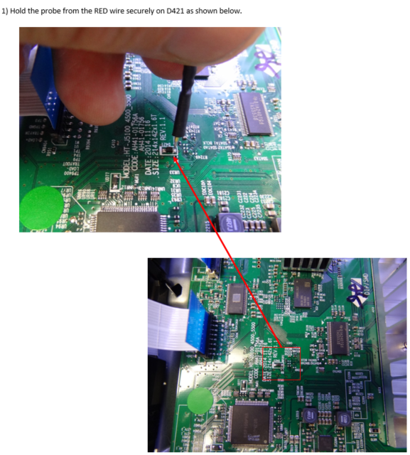
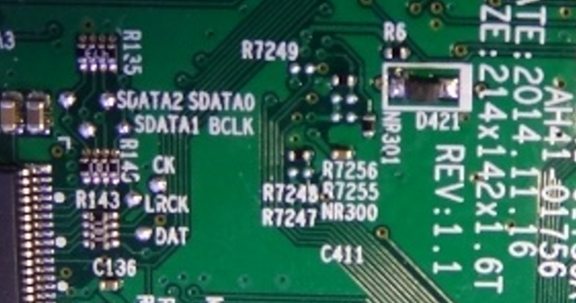

Connection
2. Repair
USB port
of HTS

Slide 5
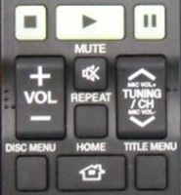
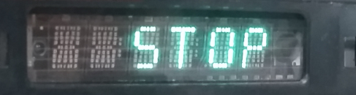
2. Repair
Press and hold TUNING/CH UP Key on the Remote
2. Plug the power cord to an outlet. Booting will start.
3. Hold the TUNING/CH key till the display shows “STOP”
※ It would take around 20 seconds till you get “STOP” from Power On.
4. Unplug the power cord for 5 seconds or more to discharge fully and re-plug the cord
5. Repeat 5times from step 1 ~ step 4

Slide 6
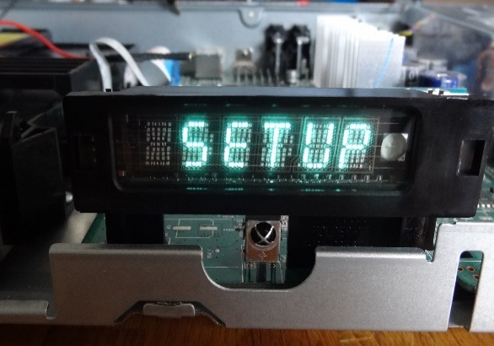
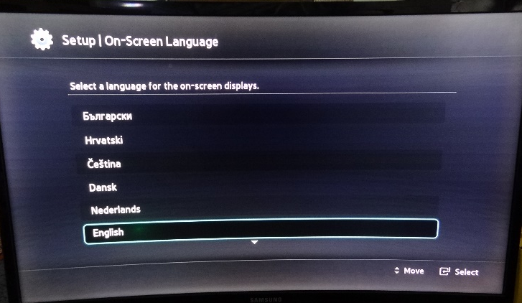
2. Repair
6. If recovery has been successful , the unit will wake up and be in initial setup mode. Check that the unit operates correctly before returning to the customer.
※ If not and the set repeats reboot, unplug the power cord for 5 sec or
more to discharge fully and repeat from step 1

